Slide 1



SYSTEM ACTIVE
139.0K+ ACTIVE MEMBERS
Powered by 20+ AI trading agents · Baseline payouts from 4%+ · Referral-driven growth
● Deposit from $20
● No KYC
● Withdraw 24/7
Open Mini App →
metatronics.global
2026

Slide 2


OVERVIEW
METATRONICS
What's inside.
01
What is METATRONICS?
06
Passive earnings potential
02
Who is it for?
07
Verifiable, on-chain profits
03
How it works
08
Partner earnings potential
04
Trading in action — live
09
A personal invitation
05
What makes us different?
metatronics.global
02 / CONTENTS

Slide 3
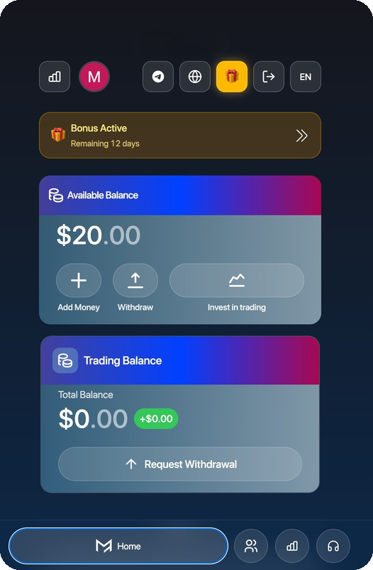
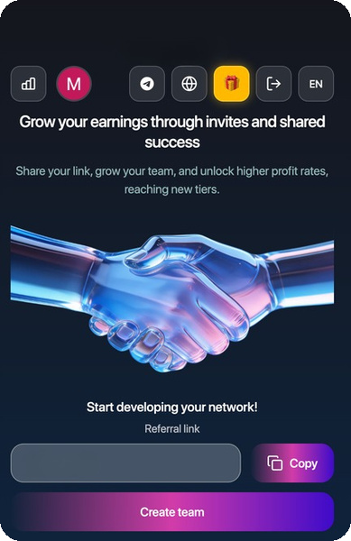
ABOUT
METATRONICS
What is METATRONICS?
METATRONICS is an AI-powered crypto trading product that gives ordinary users access to systematic trading strategies through Telegram and Web — via a simple, deposit-based model.
It is built for people who want passive exposure to algorithmic trading without managing trades themselves — and for network builders who want an active income path through referrals and team growth.
@MetatronicsBot · metatronics.global
metatronics.global
03 / DEFINITION

Slide 4
AUDIENCE
METATRONICS
Who is it for?
Passive Participants
Active Partners
Want to deposit funds and earn from AI-driven trading activity.
Want to build teams and earn from referrals and performance bonuses.
Priced-Out Investors
Crypto Users
Shut out of hedge funds or quant products, still want automated strategies.
Want a simple model — no lock-ups, no complexity, no gamified mechanics.
metatronics.global
04 / TARGET AUDIENCE

Slide 5
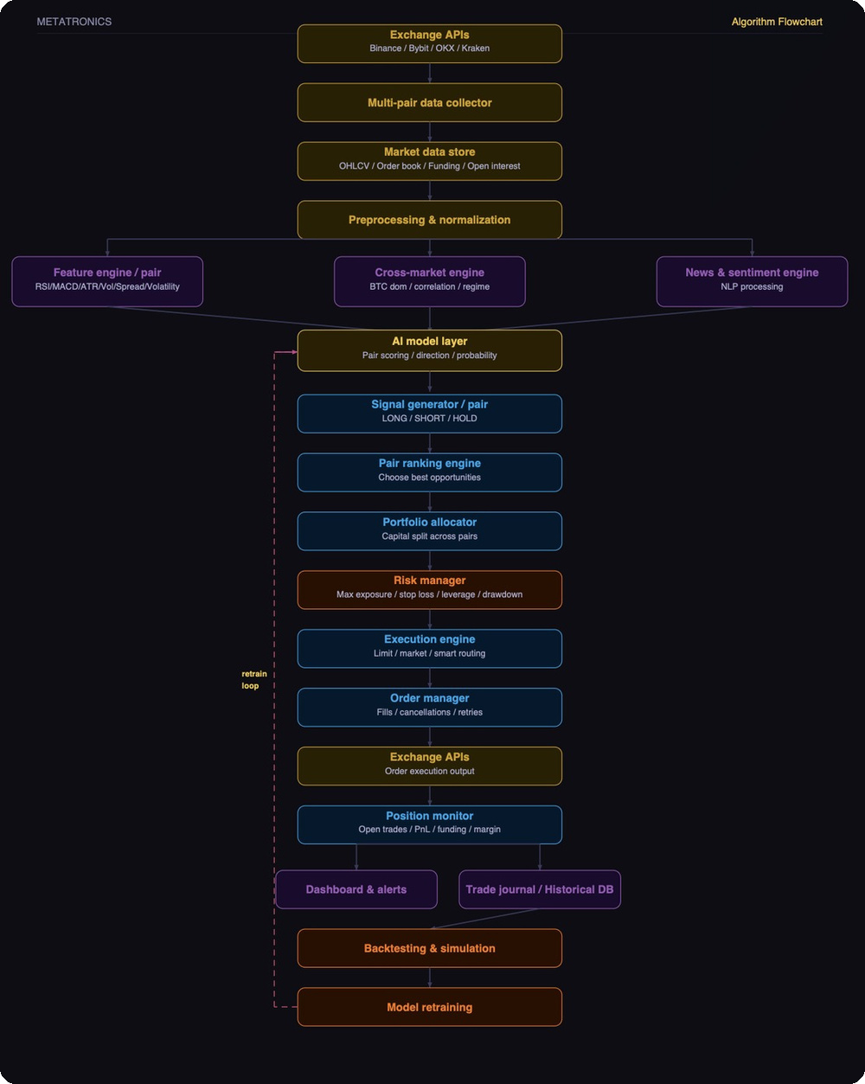
TECHNOLOGY
METATRONICS
How it works.
A multi-layer system ingesting live exchange data, processed through AI models — following the institutional logic of machine learning, portfolio construction and execution quality.
PIPELINE STAGES
Data & AI core
Analysis engines
Execution pipeline
Risk & retraining
20+
4
Exchanges
AI layers
24/7
Operation
metatronics.global
05 / TECHNICAL LOGIC

Slide 6
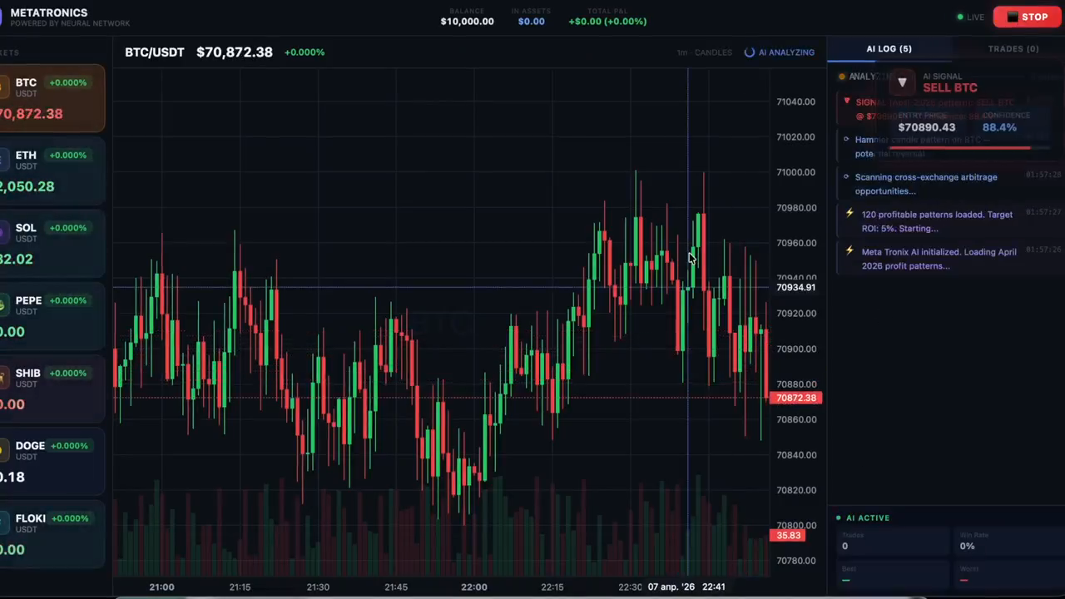
LIVE
METATRONICS
Trading in action.
LIVE
LIVE SESSION RECORDING · WATCH FULL AT METATRONICS.VIP
metatronics.global
06 / LIVE TRADING

Slide 7
WHY US
METATRONICS
What makes us different?
Transparency-first model with clear, visible operating principles
Low barrier to entry — $20 minimum deposit
Fully doxxed founding team for real accountability
No withdrawal limits — capital stays accessible
Monthly earnings reports for ongoing performance visibility
No lock-up periods for maximum flexibility
Straightforward deposit-and-growth earning structure
Transparent post-listing earning taper model
metatronics.global
07 / DIFFERENTIATORS

Slide 8
PASSIVE MODEL
METATRONICS
How much can users make?
4%+
~12%
20%
Baseline monthly
Average target
Peak months
Peak
Average
Baseline
20%
16%
12%
8%
4%
Jan
Feb
Mar
Apr
May
Jun
Jul
Aug
Sep
Oct
Nov
Dec
Target yield 4–20% per month. Returns vary with market conditions, volatility, liquidity and model adaptation.
metatronics.global
08 / PASSIVE RETURNS

Slide 9
PROOF
METATRONICS
Numbers speak louder than words.
Published
On-chain
Real-time
Monthly P&L
Trade records
Data updates
TRADING TERMINAL — MONTHLY P&L
DEMONSTRATION DATA
DATE
PAIR
TYPE
P&L
STATUS
DATE
PAIR
TYPE
P&L
STATUS
Apr 01
BTC/USDT
LONG
+$3,412
PROFIT
Apr 08
SOL/USDT
SHORT
+$1,560
PROFIT
Apr 02
ETH/USDT
SHORT
+$1,820
PROFIT
Apr 09
BNB/USDT
LONG
+$3,220
PROFIT
Apr 03
SOL/USDT
LONG
-$640
LOSS
Apr 10
BTC/USDT
LONG
-$480
LOSS
Apr 04
BNB/USDT
LONG
+$2,105
PROFIT
Apr 11
ETH/USDT
SHORT
+$2,890
PROFIT
Apr 05
BTC/USDT
SHORT
+$4,775
PROFIT
Apr 12
DOT/USDT
LONG
+$1,140
PROFIT
Apr 06
ETH/USDT
LONG
-$320
LOSS
Apr 13
BTC/USDT
LONG
+$5,330
PROFIT
Apr 07
ADA/USDT
LONG
+$890
PROFIT
Apr 14
SOL/USDT
SHORT
-$290
LOSS
metatronics.global
09 / VERIFIABLE PROFITS

Slide 10
ACTIVE MODEL
METATRONICS
How much can partners make?
A referral-driven growth model that rewards community expansion.
AFFILIATE STRUCTURE — 10 LEVELS
Cash Bonuses
LINE
COMMISSION
TURNOVER
Large cash rewards up to 500,000 USDT for highly active users.
01
10%
$100 deposit
02
5%
$1,000 volume
03
3%
$2,000 volume
Rank System
Built-in ranks reward users as they hit defined milestones.
04
2%
$3,000 volume
05
1%
$4,000 volume
06
1%
$5,000 volume
KPI Bonuses
07
0.5%
$6,000 volume
Custom performance-based bonuses for top partners.
08
0.5%
$7,000 volume
09
0.5%
$8,000 volume
10
0.5%
$10,000 volume
$100 personal deposit opens line 1. Every $1,000 in total team volume unlocks +1 level (up to 10).
metatronics.global
10 / REFERRAL STRUCTURE

Slide 11

JOIN US
A personal invitation.
You're invited to join METATRONICS — where the algorithm works 24/7 so you don't have to.
Start with $20
No lock-up
Blockchain verified
Minimum deposit
Withdraw anytime
Full transparency
metatronics.global
@MetatronicsBot
@metatronics_
METATRONICS · 2026

